Slide 1

Gatorscribe
Start
Title |
Time Signature
Key Signature
Tempo
Playback Instrument

Slide 2
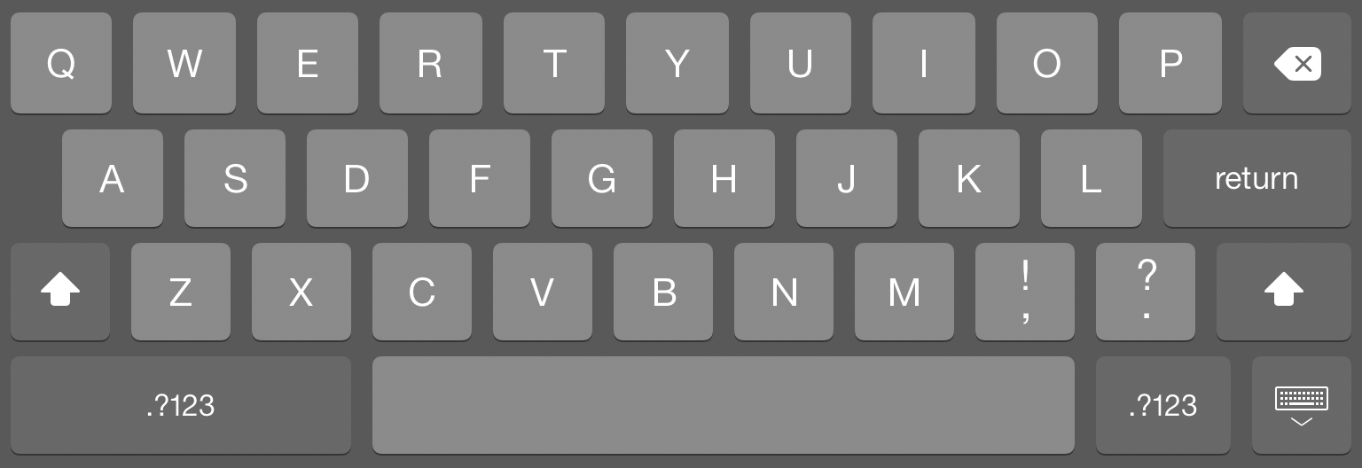
Song Title
Title |

Slide 3
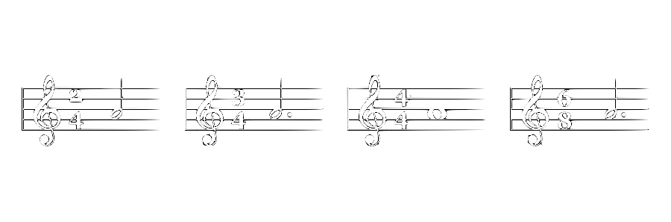
Time Signature

Slide 4
Key Signature
C
C
C#
C#
Db
Major
minor
Major
minor
Major
D
D
D#
Eb
Eb
Major
minor
minor
Major
minor
E
E
F
F
F#
Major
minor
Major
minor
Major
F#
Gb
G
G
G#
minor
Major
Major
minor
minor
Ab
Ab
A
A
A#
Major
minor
Major
minor
minor
Bb
Bb
B
B
Cb
Major
minor
Major
minor
Major

Slide 5

Tempo
Back

Slide 6
Playback Instrument

